Slide 1
JavaScript
Team Nock-Nock
Nathan Davids
Okuhle Charlieman
Cole Hanekom
Kiran Isaacs

Slide 2
Content
01
02
03
04
Variables,
Strings, Operators & Assignments
Arrays
Functions
Booleans

Slide 3
Variables,Strings
Variables are containers for storing data (storing data values).
String is a data type that allows you to store a series of characters

Slide 4
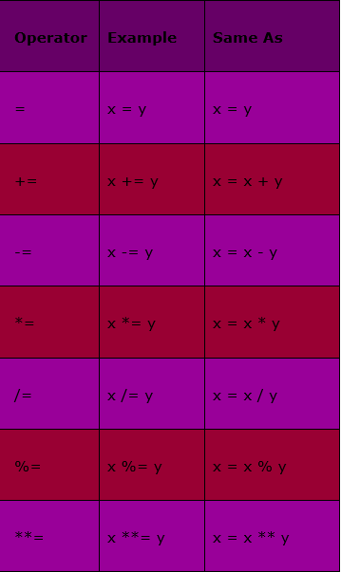
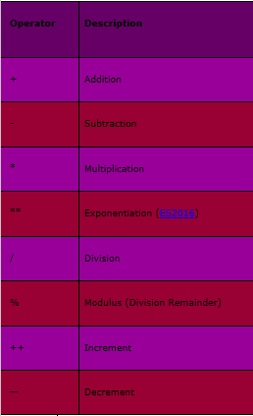
Operators & Assignments

Slide 5
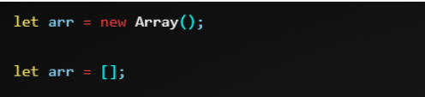
Arrays
Arrangement of numbers or objects formatted into rows and columns according to their type.
Helpful to store a list or items on a website.
Two syntaxes for creating an empty array:
Array elements are numbered starting from zero.
Add , replace and get length of Array

Slide 6


Functions
designed to perform a particular task.
defined with the function keyword, followed by a name, followed by parentheses ().
Function names can contain letters, digits, underscores, and dollar signs
The parentheses may include parameters
The code to be executed, is placed inside curly brackets: {}

Slide 7
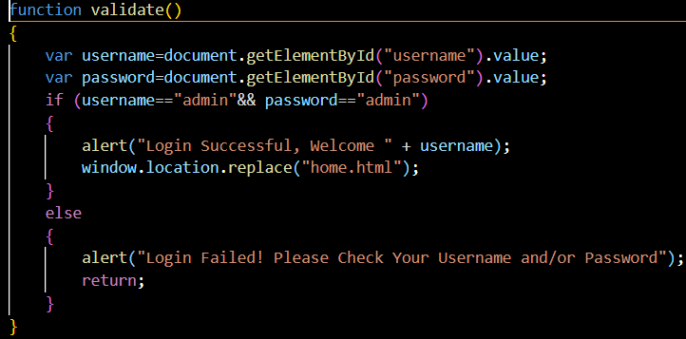
Booleans
JS
Booleans are values that can be one of two things: true or false
Can be used in conjunction with:
Variables
Operators
Conditions

Slide 8


Slide 9
Thank You!
Do you have any questions?

